Slide 1
Advanced Prompt Engineering

Slide 2


Slide 3
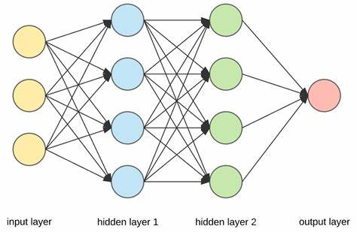
Neural Networks

Slide 4
What are Large Language Models (LLMs)?
Neural network architectures used for natural language processing tasks.
Can be used to predict the next word in a sentence or recognize the structure of a sentence.
Trained on massive datasets of text using huge clusters of GPUs.
Basically - Give it text, it will determine the most likely text that follows.
Google published research on transformer models for training LLMs in 2017.
Google BERT and OpenAI GPT-2 follow soon afterwards. Open only to researchers
OpenAI releases ChatGPT to the public in Nov 2022 “in a panic”

Slide 5
OpenAI’s GPT by the numbers
GPT-1 had 117 million parameters to work with, GPT-2 had 1.5 billion parameters, and GPT-3 arrived in February of 2021 with 175 billion parameters.
GPT-3 was trained on a dataset of over 570GB of text data, or roughly 300 billion words.
GPT-3 was trained on a cluster of 285k CPU cores and 10k GPUs.
The training cost for GPT-3 was estimated to be around $4.6 million
It would take 355 years to train GPT-3 on a single NVIDIA Tesla V100 GPU.
Requires somewhere around 300GB of RAM just to load the weights to run the model.

Slide 6
Demo: OpenAI Playground

Slide 7
Basic Prompt Engineering
The quality of results depends on how much information you provide and how it is crafted.
Provide tone and style guidelines
“Explain the history of AI” vs
“Explain the history of AI in a brief and catchy way”
Use a thesaurus -
“Make this text shorter” vs “Condense this text”
Provide examples:
No examples = Zero-Shot Prompting
Several examples = Few-Shot Prompting
Specify format of output
Bulleted, JSON, headers/footers, etc
If you want a very specific output provide examples
Spacing, sections, labels, characters, all count

Slide 8
Basic Prompt Engineering
A prompt contains any of the following elements:
Instruction - a specific task or instruction you want the model to perform
Context - external information or additional context that can steer the model to better responses
Input Data - the input or question that we are interested to find a response for
Output Indicator - the type or format of the output.

Slide 9
Basic Prompt Engineering
Today, we are writing a professional email to a group of colleagues. Rewrite the email message below to be more clear and concise and suggest a subject. Email Body: """ body text... """ Format the output as follows Subject: Your suggested subject Body: The rewritten body Subject:
Context
Other versions: “You are a bot that…”
Instruction Input data Three quotes works well to delimit your input Output example Prompt to start the completion

Slide 10
Demo: Few-Shot Prompting

Slide 11
Advanced Prompt Engineering
Chain-of-Thought
Self-Consistency
Generate Knowledge Prompting
Automatic Prompt Engineer
Active-Prompt
ReACT
Directional Stimulus Prompting
Multimodal CoT
Graph Prompting

Slide 12
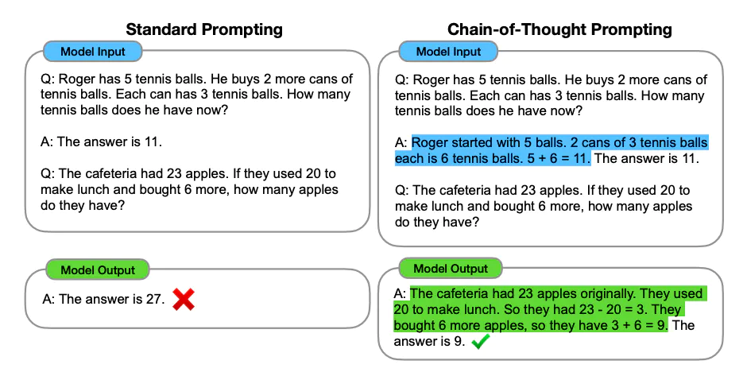
Chain-of-Thought Prompts
Instead of just giving an answer, tell the LLM to show it’s thought process
Simple version - just append the phrase “Let’s think step by step” to the prompt

Slide 13
Demo: Chain-of-Thought

Slide 14
Limitations
Most models last trained around the end of 2021
ChatGPT current as of Sept 2021
GPT4 is newer, but won’t be using that today
You can’t train the model with your own data
Unless you have $5 million laying around and can convince OpenAI to include your data
4k “tokens” max across request and response
Token is kind of like a word, but not really - https://platform.openai.com/tokenizer
Often “hallucinates” (i.e. makes stuff up)
Not always great at understanding context, following logic, performing calculations
It’s a language model, not a calculation engine (e.g. Wolfram|Alpha)

Slide 15


Slide 16
OpenAI API

Slide 17
Demo: Basic Completion

Slide 18
Embeddings
What is it?
A measure of the “relatedness” of text
Really - A thousand+ dimension vector describing the text
Can be used for:
Search
Clustering
Recommendations
Classification
Anomaly detection
Diversity measurement

Slide 19
Demo: Generate embeddings

Slide 20
Using Embeddings to Augment Knowledge
Common scenario: I want to use GPT to answer questions about my own data
But… you can’t retrain GPT with your own data
Unless you have $5 million dollars lying around and access to OpenAI’s model
However, you can:
Calculate embeddings for each chunk
Store embeddings with reference to the actual content in a database
Create embedding for your question
Find closest document chunk(s) to your question
Take the top n chunks and add them as context for your prompt

Slide 21
Demo: Search with embeddings

Slide 22
Dealing with large datasets
Vector Databases
PineCone
Weaviate
ChronosDB
Redis has a vector distance function
Large documents must be split into chunks GPT can handle
Must be split by “tokens”, not words or letters, libraries exist to do this
Other strategies include using GPT to summarize chunks
Summarize the summaries recursively
Store in a summary tree for indexing
Libraries exist to do this

Slide 23
Fine-Tuning
Provide your own example responses to “fine-tune” responses
Doesn’t retrain the underlying model, really a layer on top
Only supports Question/Answer training
Seems to be similar to other older AI language models
i.e. - Requires lots of pre-defined examples to work well
Not going to go over this here

Slide 24
Integrating external tools
Remember some of the limitations of LLMs:
Only know about the world when it was trained
ChatGPT last trained Sept 2021
Not great some tasks - e.g. performing calculations
How can we use other tools to augment the LLM’s capabilities?
Notes:
“Relatedness” is how they describe it in the documentation.
Relatedness to what? Other text! So what’s the actual value then?
What can you do with a 1000 dimension vector?
Well, you can compare it. Specifically, in any number of dimensions you can calculate distance

Slide 25
Demo: External tools

Slide 26
ReAct
Reasoning Traces and Task-specific Actions
Given a goal tell the LLM to create a thought, determine the next action, observe results, repeat until complete
Integrate with external tools to perform the actions and fill in observations.

Slide 27
{Initial prompt with Thought/Action/Observation example and available actions...} Question: What is the elevation range for the area that the eastern sector of the Colorado orogeny extends into? Thought 1: I need to search Colorado orogeny, find the area that the eastern sector of the Colorado orogeny extends into, then find the elevation range of the area. Action 1: Search[Colorado orogeny] Observation 1: The Colorado orogeny was an episode of mountain building (an orogeny) in Colorado and surrounding areas. Thought 2: It does not mention the eastern sector. So I need to look up eastern sector. Action 2: Lookup[eastern sector] Observation 2: (Result 1 / 1) The eastern sector extends into the High Plains and is called the Central Plains orogeny. Thought 3: The eastern sector of Colorado orogeny extends into the High Plains. So I need to search High Plains and find its elevation range. Action 3: Search[High Plains] Observation 3: High Plains refers to one of two distinct land regions Thought 4: I need to instead search High Plains (United States). Action 4: Search[High Plains (United States)] Observation 4: The High Plains are a subregion of the Great Plains. From east to west, the High Plains rise in elevation from around 1,800 to 7,000 ft (550 to 2,130m).[3] Thought 5: High Plains rise in elevation from around 1,800 to 7,000 ft, so the answer is 1,800 to 7,000 ft. Action 5: Finish[1,800 to 7,000 ft]

Slide 28
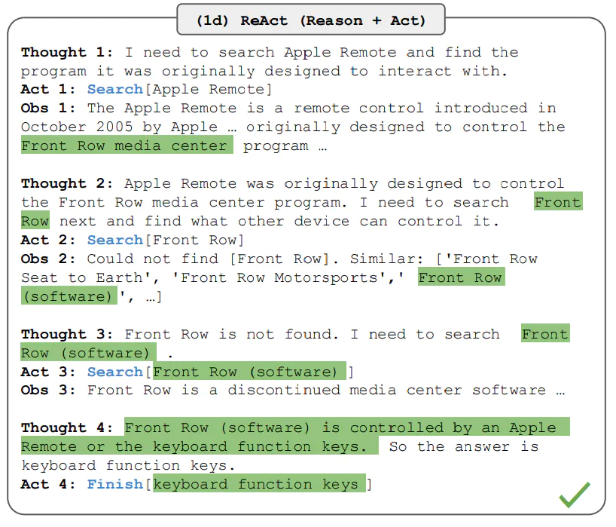

Slide 29
What if we brought it all together?
Create multiple external actions the LLM can request to execute
Incorporate document scanning, tokenization, and a vector database as “long-term” memory for the AI
Use ReACT + Chain-of-Thought style strategy to recursively figure out the next task to perform
Wrap it in a modular framework where you can add your own agents/tools/actions/etc
Give the AI a task or goal, and it will autonomously try to accomplish it for you

Slide 30
AI Agents
LangChain
Probably the most “mature” (relative term for this space)
Framework to combine tools to answer questions
AutoGPT
Give the AI a goal and it will attempt to autonomously complete it
BabyAGI
Creates tasks based on the result of previous tasks and a predefined objective.
Microsoft Jarvis
Microsoft’s research project to create a “Jarvis-like” agent
AgentGPT, GodMode
Meant to be useable by non-programmers

Slide 31
LangChain Modules
Prompts - templates, management, optimization, and serialization
Document loaders - load and feed unstructured data from a variety of sources and formats.
Chains - combine multiple LLM calls in a sequence enabling more complex workflows.
Tools - A function that performs a specific duty, such as Google Search, Database lookup, Python REPL, etc.
Agents - Make observations and decisions on which actions to take to accomplish a particular task.
Memory - Maintain short and long-term memory of previous interactions

Slide 32
Demo: LangChain

Slide 33
So what happened here?

Slide 34
Answer the following questions as best you can. You have access to the following tools: Search: A search engine. Useful for when you need to answer questions about current events. Input should be a search query. Calculator: Useful for when you need to answer questions about math. Use the following format: Question: the input question you must answer Thought: you should always think about what to do Action: the action to take, should be one of [Search, Calculator] Action Input: the input to the action Observation: the result of the action ... (this Thought/Action/Action Input/Observation can repeat N times) Thought: I now know the final answer Final Answer: the final answer to the original input question Begin! Question: What is Tesla's market capitalization as of March 3rd 2023, how many times bigger is this than Ford's market cap on the same day? Thought:
Notes:
LangChain started with this zero-shot prompt demonstrating the ReAct format. It adds a parameter that tells GPT to stop if it generates the text "Observation:" because we're not interested in GPT's made up observation.

Slide 35
{... zero shot prompt omitted } Question: What is Tesla's market capitalization as of March 3rd 2023, how many times bigger is this than Ford's market cap on the same day?
Thought: I need to find the market capitalization of both companies
Action: Search
Action Input: "Tesla market capitalization March 3rd 2023"
Notes:
GPT completed the text with this
GPT would have contiuned with a made up Observation section too, but we told the API to stop when it got to that.
Langchain parses the "Action" and "Action Input" and executes the Google tool.

Slide 36
{... zero shot prompt omitted } Question: What is Tesla's market capitalization as of March 3rd 2023, how many times bigger is this than Ford's market cap on the same day? Thought: I need to find the market capitalization of both companies Action: Search Action Input: "Tesla market capitalization March 3rd 2023" Observation: At the time of writing, Tesla has a market capitalization of $585.55 billion, up significantly from the $389 billion it had ending 2022. The ... Thought:
Notes:
The result is then put into the observation, and sent back to GPT...

Slide 37
{... zero shot prompt omitted } Question: What is Tesla's market capitalization as of March 3rd 2023, how many times bigger is this than Ford's market cap on the same day? Thought: I need to find the market capitalization of both companies Action: Search Action Input: "Tesla market capitalization March 3rd 2023" Observation: At the time of writing, Tesla has a market capitalization of $585.55 billion, up significantly from the $389 billion it had ending 2022. The ... Thought: I need to find the market capitalization of Ford Action: Search Action Input: "Ford market capitalization March 3rd 2023"
Notes:
LangChain once again parses the response and executes a Google search and puts the result into a new request to GPT:

Slide 38
{... zero shot prompt omitted } Question: What is Tesla's market capitalization as of March 3rd 2023, how many times bigger is this than Ford's market cap on the same day? Thought: I need to find the market capitalization of both companies Action: Search Action Input: "Tesla market capitalization March 3rd 2023" Observation: At the time of writing, Tesla has a market capitalization of $585.55 billion, up significantly from the $389 billion it had ending 2022. The ... Thought: I need to find the market capitalization of Ford Action: Search Action Input: "Ford market capitalization March 3rd 2023" Observation: Ford stock increased by 10 percent or $1.20 per share during the February 27th - March 3rd, 2023 period. See Ford stock performance details ... Thought:
Notes:
Note this is wrong - LangChain uses the SERP API to get Google results, but it only uses the page summaries from Google, which often don't have the answer, and instead GPT incorrectly used two market capitalizations from the first Tesla result, woops!
LangChain then uses the Calculator tool.
This actually uses GPT to generate Python code! (Do you want to see it?)

Slide 39
{... zero shot prompt omitted } Question: What is Tesla's market capitalization as of March 3rd 2023, how many times bigger is this than Ford's market cap on the same day? Thought: I need to find the market capitalization of both companies Action: Search Action Input: "Tesla market capitalization March 3rd 2023" Observation: At the time of writing, Tesla has a market capitalization of $585.55 billion, up significantly from the $389 billion it had ending 2022. The ... Thought: I need to find the market capitalization of Ford Action: Search Action Input: "Ford market capitalization March 3rd 2023" Observation: Ford stock increased by 10 percent or $1.20 per share during the February 27th - March 3rd, 2023 period. See Ford stock performance details ... Thought: I need to compare the two market capitalizations Action: Calculator Action Input: 585.55 billion / 389 billion
Notes:
Note this is wrong - LangChain uses the SERP API to get Google results, but it only uses the page summaries from Google, which often don't have the answer, and instead GPT incorrectly used two market capitalizations from the first Tesla result, woops!
LangChain then uses the Calculator tool.
This actually uses GPT to generate Python code! (Do you want to see it?)

Slide 40
{... zero shot prompt omitted }
Question: What is Tesla's market capitalization as of March 3rd 2023, how many times bigger is this than Ford's market cap on the same day?
Thought: I need to find the market capitalization of both companies
Action: Search
Action Input: "Tesla market capitalization March 3rd 2023"
Observation: At the time of writing, Tesla has a market capitalization of $585.55 billion, up significantly from the $389 billion it had ending 2022. The ...
Thought: I need to find the market capitalization of Ford
Action: Search
Action Input: "Ford market capitalization March 3rd 2023"
Observation: Ford stock increased by 10 percent or $1.20 per share during the February 27th - March 3rd, 2023 period. See Ford stock performance details ...
Thought: I need to compare the two market capitalizations
Action: Calculator
Action Input: 585.55 billion / 389 billion Observation: Answer: 1.5052699228791773
Thought:
Notes:
LangChain uses this to fill in the observation for one last GPT call:

Slide 41
{... zero shot prompt omitted }
Question: What is Tesla's market capitalization as of March 3rd 2023, how many times bigger is this than Ford's market cap on the same day? Thought: I need to find the market capitalization of both companies Action: Search Action Input: "Tesla market capitalization March 3rd 2023" Observation: At the time of writing, Tesla has a market capitalization of $585.55 billion, up significantly from the $389 billion it had ending 2022. The ... Thought: I need to find the market capitalization of Ford Action: Search Action Input: "Ford market capitalization March 3rd 2023" Observation: Ford stock increased by 10 percent or $1.20 per share during the February 27th - March 3rd, 2023 period. See Ford stock performance details ... Thought: I need to compare the two market capitalizations Action: Calculator Action Input: 585.55 billion / 389 billion Observation: Answer: 1.5052699228791773 Thought: I now know the final answer Final Answer: Tesla's market capitalization is 1.5 times bigger than Ford's market capitalization as of March 3rd 2023.
Notes:
LangChain uses this to fill in the observation for one last GPT call:

Slide 42
How LangChain did the math

Slide 43
Translate a math problem into a expression that can be executed using Python's numexpr library. Use the output of running this code to answer the question. Question: ${Question with math problem.} ```text ${single line mathematical expression that solves the problem} ``` ...numexpr.evaluate(text)... ```output ${Output of running the code} ``` Answer: ${Answer} Begin. Question: What is 37593 * 67? ```text 37593 * 67 ``` ...numexpr.evaluate(\"37593 * 67\")... ```output 2518731 ``` Answer: 2518731 Question: 585.55 billion / 389 billion
Notes:
Sends this separate prompt to GPT:
This specifies to stop when GPT generates the string "```output"

Slide 44
Translate a math problem into a expression that can be executed using Python's numexpr library. Use the output of running this code to answer the question. Question: ${Question with math problem.} ```text ${single line mathematical expression that solves the problem} ``` ...numexpr.evaluate(text)... ```output ${Output of running the code} ``` Answer: ${Answer} Begin. Question: What is 37593 * 67? ```text 37593 * 67 ``` ...numexpr.evaluate(\"37593 * 67\")... ```output 2518731 ``` Answer: 2518731 Question: 585.55 billion / 389 billion
```text 585.55e9 / 389e9 ``` ...numexpr.evaluate(\"585.55e9 / 389e9\")...
Notes:
And gets some Python code to execute

Slide 45
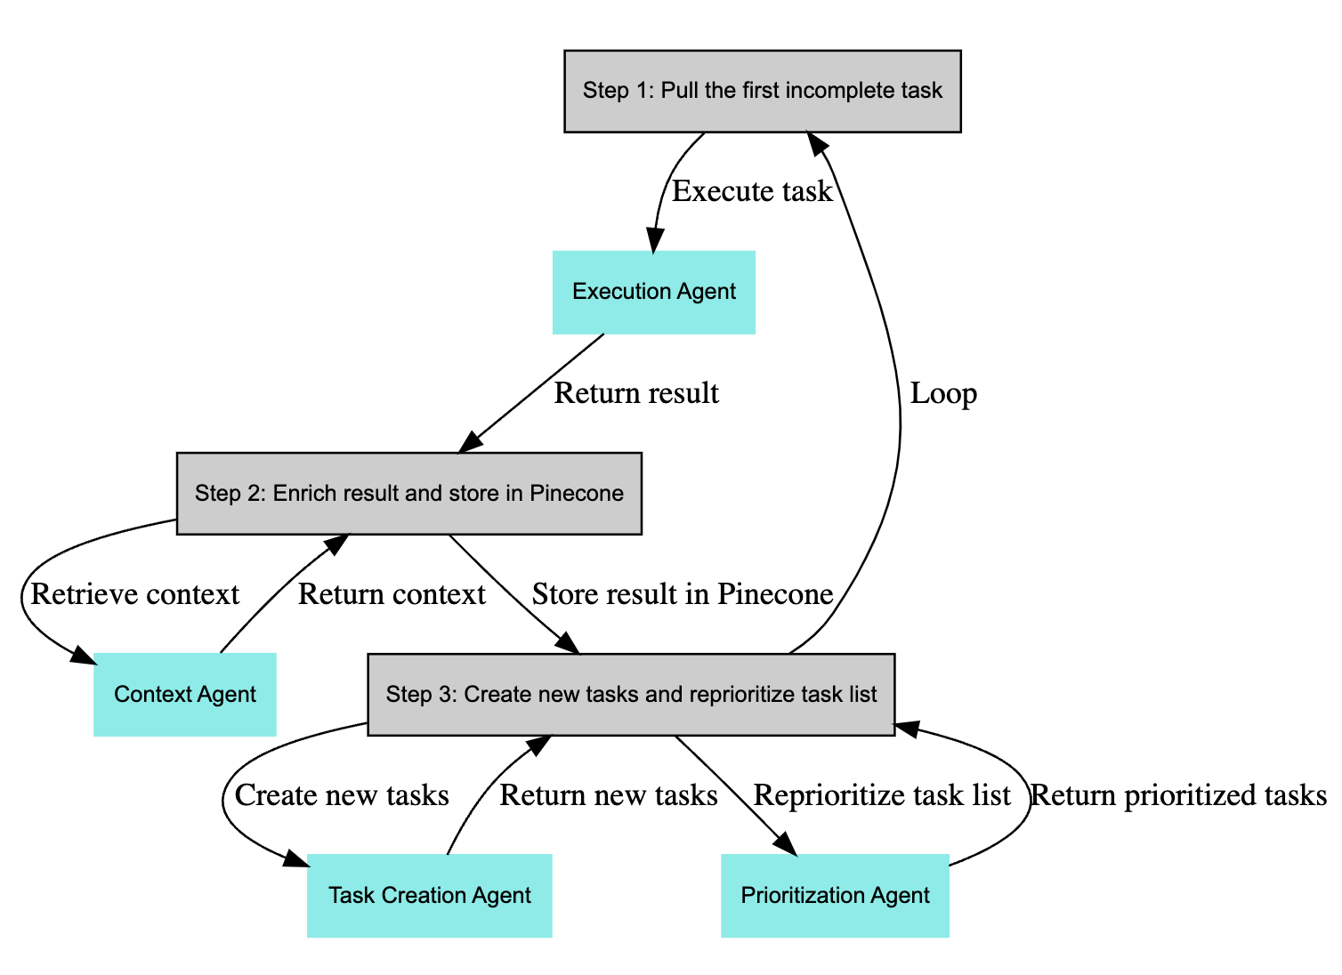
BabyAGI workflow

Slide 46
So where is this going?

Slide 47
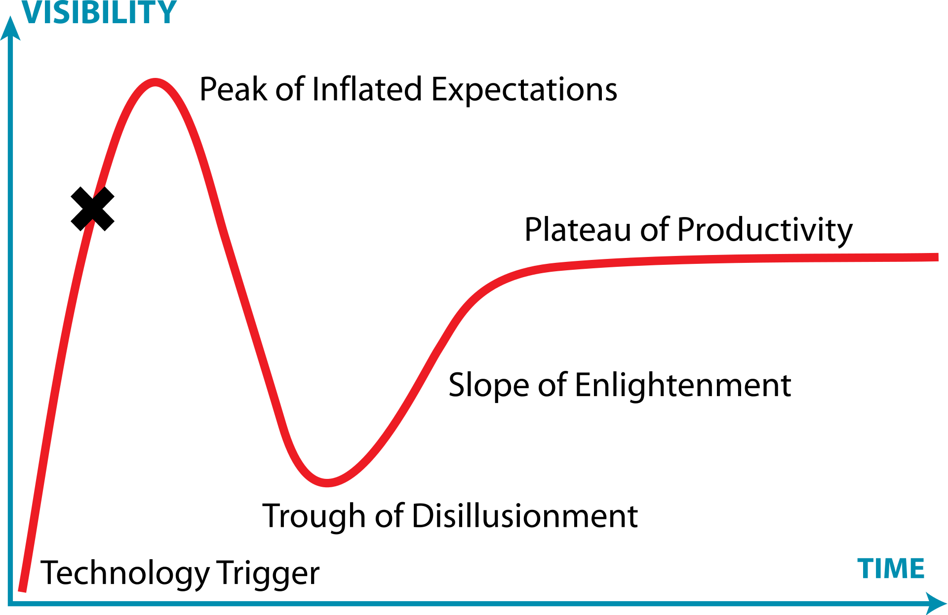
Predictions

Slide 48
The new UI is Clippy chatbots
Interpreting text as a command is not new (Alexa, etc)
What’s new is the ability for LLMs to “reason”
Microsoft:
Github Co-pilot
Co-pilot X
Pull requests
AI command line interface
Bing Search
Office 365 Copilot
Outlook
Word
Teams - transcribe and summarize meetings
Or worse ideas…
https://www.youtube.com/watch?v=XEM5qz__HOU

Slide 49
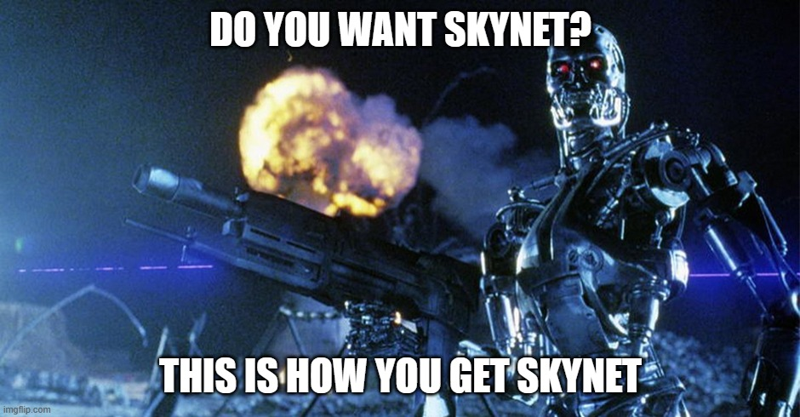

Slide 50
And so many more new topics...
New security holes (prompt injection attacks)
Ethical concerns
The future of copyright
New ways of working (developer workflow?)
What jobs will be replaced by AI?

Slide 51
Resources
OpenAI playground:
https://platform.openai.com/playground?mode=complete
Guide on many of these prompt strategies:
https://www.promptingguide.ai/
Example of exactly what LangChain is sending to GPT:
https://tsmatz.wordpress.com/2023/03/07/react-with-openai-gpt-and-langchain/
Using embeddings for search
https://github.com/openai/openai-cookbook/blob/main/examples/Question_answering_using_embeddings.ipynb
AutoGPT
https://github.com/Significant-Gravitas/Auto-GPT

